Slide 1
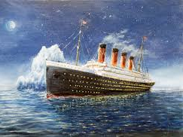
Titanic Classification Project
Class: Summer Machine Learning Class 2025 (Horizons Quest)
Instructor: Dr. Bhishan Poudel
Programmer: Aditya Narayan
Date: 08/13/2025

Slide 2
Why this Project?
Part of STEMPeers/Horizons Quest Summer Project
Mentored through Dr. Bhishan Poudel
Learning basics behind AI/ML models
Using our skills to build ML models

Slide 3
Goal of the Project
Titanic is a famous shipwreck from 1912
Goal of the project: Compare different Machine learning models to figure out whether a passenger will survive or not based on the available Titanic data

Slide 4
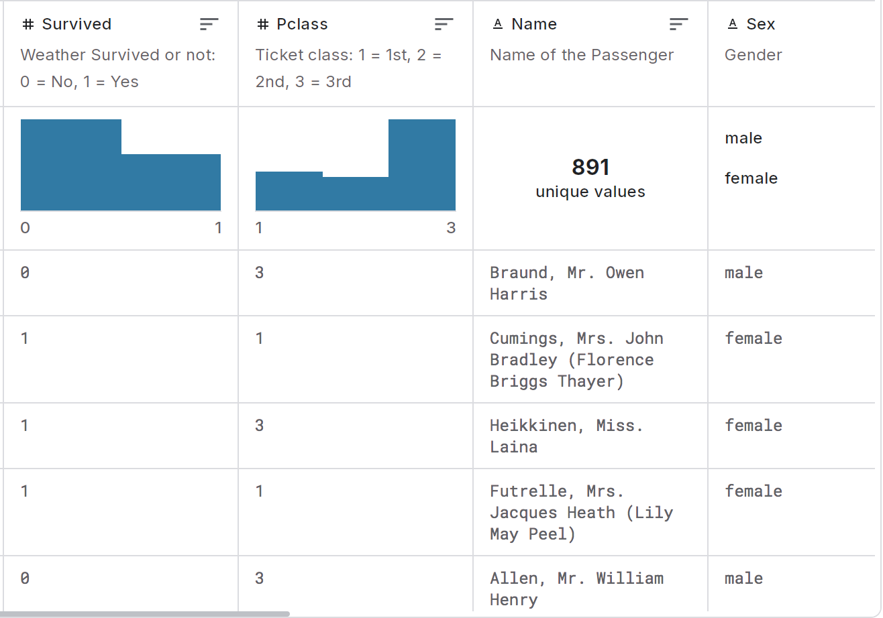
Data Source
Dataset Source: Kaggle, curated by M YASSER H
Data from 891 passengers
Metadata: Name, Age, Gender, Cabin, Survived or not, Boarding stop

Slide 5
Process
Data download from kaggle on Google colab
Clean and remove empty or missing values, eg; NAN
Cabin, where passengers resided, are all unique, so only considered the deck
Missing age values were filled with mean age
Embarked from: Missing values were filled with the most common embarking spot
Convert non-numerical values to numerical values for the models
Split data into 80-20 split using the 80% for training the models and 20% for testing
Randomness was set to 100 to avoid the model’s access to the test data

Slide 6
Models Used + Accuracy
Model | Accuracy (%)
Logistic Regression | 82
Gradient Boosting | 81
AdaBoost | 80
Decision Tree | 79
Random Forest | 79
Naive Bayes | 79
K-Nearest Neighbors | 70
SVM (Support Vector Machines) | 66
Click my github for more information on this project

Slide 7
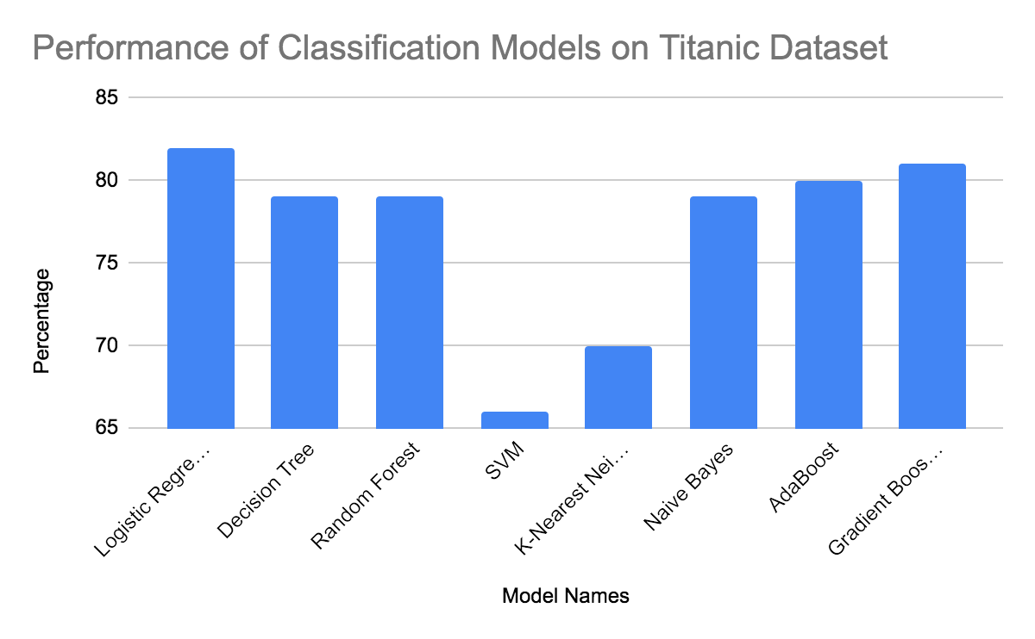
Data Analysis
Logistic Regression model : Performed the best, it handles data without tuning well
SVM and KNN model: Performed the worst, both models require fine tuning to data which I did not do
Adding the cabin variable boosted some models performance slightly (data without cabin inclusion not shown)

Slide 8
Thank You
Thanks to Dr. Bhishan Poudel and Horizons Quest Program
Thanks for the opportunity to learn about
Basics of AI/ML models
Many new ML models and how they work
GitHub Repositories
Operating Google Colab in cooperation with Github
Tricks in ML model coding
More details on cleaning the data
Specifics of the Titanic and its passengers

